Slide 1


Étude de Marché
Market Research

Slide 2

Context
Data for the study
Population
Food availability
La Poule Qui Chante – a French a French food company producing chicken products
We want to develop internationally – but where?
Large field of possibilities – this study will allow us to identify the best options.
Politics
Economics
Political stability
GDP per capita
Sociocultural context
Technology
Chicken available
per capita
Agricultural credit
Ecology
Legal
Emissions from chicken production
Government investment in agriculture
https://www.fao.org/faostat/en/?#data

Slide 3

Preparation & Cleaning General Steps
Import the Python libraries
Import the CSV files
For each file:
Check the head and shape of the dataframe and then check the types of data
Check if there are null values
Delete the columns that will not be used for the analysis
Check if ‘Zone’can be used as a primary key.
Merge the files

Slide 4

Final merged file
Find the null values:
GDP (1) – Taiwan data was missing. I used data from the IMF
Political stability (4) – I used IMF data for China and Taiwan. I used the political stability of France for New Caledonia and French Polynesia as they overseas territories of France.
Government investment (29) and agricultural credit (62) – the FAO explained that the response rates for these data are relatively low. I replaced the zero values with the average values of each column.
Emissions (4) - Djibouti and Maldives do not produce chicken(no emissions), FAO has data for Iceland for 2013 and 2019, and data for Latvia up to 2016. I have respectively interpolated and extrapolated the data.

Slide 5

Exploratory analysis of the final merged file
Check type of data in each column
Use ‘describe’ to check the les min, max, quartiles et standard deviation of each column
Create a boxplot and a histogram for each column
Check for outliers for each column

Slide 6

Results

Slide 7

Hierarchical Ascending Classification
Data normalisation
Create clusters using the Ward method
Create a dendrogram with these clusters
Determine the optimal number of clusters using the Davies-Bouldin index
Create a contingency table and a heatmap
Create a list of clusters with the countries in each cluster
Perform deeper cluster analysis – “describe()” function, boxplots and histograms

Slide 8
Hierarchical Ascending Classification PESTEL analysis
Cluster 1
Cluster 2
Cluster 3
Politics
Politics
Politics
Political stability - low
Political stability - medium
Political stability - high
Economics
Economics
Economics
GDP per capita - low
GDP per capita - medium
GDP per capita - high
Sociocultural context
Sociocultural context
Sociocultural context
Chicken available - low
Chicken available - high
Chicken available - medium
Technology
Technology
Technology
Agricultural credit - low
Agricultural credit - medium
Agricultural credit - high
Ecology
Ecology
Ecology
Emissions - high
Emissions - medium
Emissions - low
Legal
Legal
Legal
Government investment - low
Government investment - medium
Government investment - High

Slide 9

K-means cluster analysis
Determine the optimal number of clusters (4) – use the elbow method
Use the optimal number of clusters to instantiate the k-means, then train them
Add the centroids of each k-means cluster to a variable called “centroids”
Scale column values and train PCA with scaled data and 4 components
Visualize clusters and their centroids
Create a list of clusters with the countries in each cluster
Perform deeper cluster analysis – “describe()” function, boxplots and histograms

Slide 10
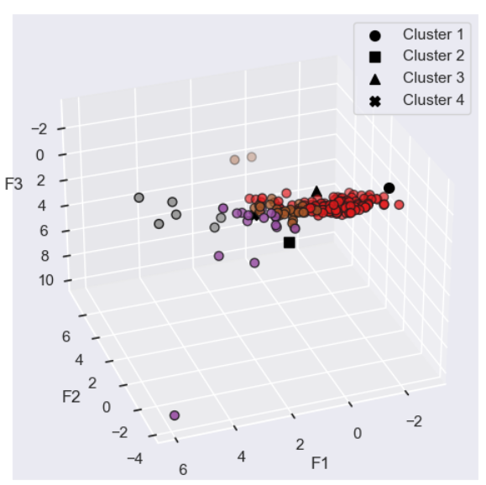
K-means cluster analysis
Cluster centroid 1 is relatively far from cluster centroid 2 and cluster centroid 4.
In contrast, the centroid of cluster 3 is close to 1, 2 and 4.
The centroids of clusters 2 and 3 are the most similar clusters.

Slide 11
K-means cluster PESTEL analysis
Poorer Countries
High chicken consumption, high GDP
High chicken consumption, medium GDP
Richer countries
Politics
Politics
Politics
Politics
Political stability - low
Political stability - medium
Political stability - medium
Political stability - high
Economics
Economics
Economics
Economics
GDP per capita - low
GDP per capita - high (2nd)
GDP per capita - medium
GDP per capita – high (1st)
Sociocultural context
Sociocultural context
Sociocultural context
Sociocultural context
Chicken available - low
Chicken available - high
Chicken available - high
Chicken available - medium
Technology
Technology
Technology
Technology
Agricultural credit - low
Agricultural credit - high
Agricultural credit - medium
Agricultural credit - medium
Ecology
Ecology
Ecology
Ecology
Emissions - high
Emissions - low
Emissions - medium
Emissions - low
Legal
Legal
Legal
Legal
Government investment - low
Government investment - medium
Government investment - medium
Government investment - high

Slide 12

Countries to examine
HAC
Finland
Ireland
Iceland
Luxembourg
Norway
New Zealand
Switzerland
K-means
Germany
Australia
Austria
Belgium
Belize
Canada
China - Hong Kong SAR
Denmark
Finland
Israel
Japan
New Zealand
The Netherlands
United Kingdom
Sweden
United Arab Emirates
United States of America

Slide 13
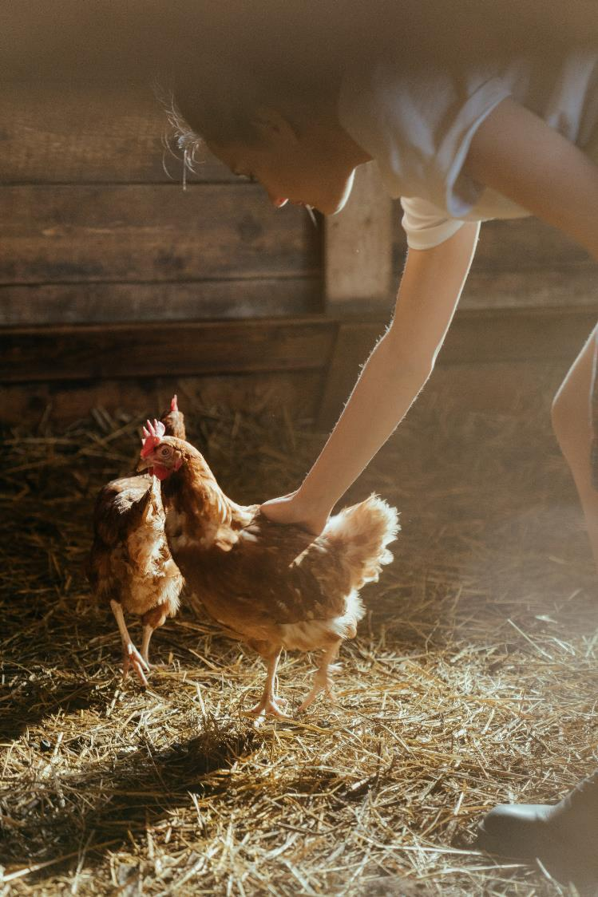
Principal Component Analysis
Separate the quantitative values from the original dataframe.
Train the scaler with these values and transform the data.
Create a PCA and train it with the scaled data
Calculate data variance to understand the contribution of each feature and determine the optimal number of components.
Create a heatmap
Draw a correlation circle and project the different countries onto the factorial planes.
Analyse countries from these graphs.

Slide 14
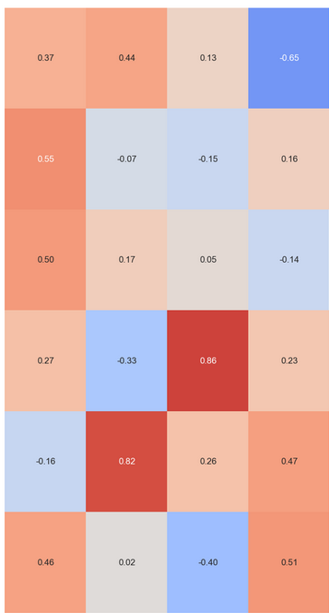
PCA – Principal Components
F1
F2
F3
F4
Poultry meat- Food available (kg/person/year)
GDP (US$) per capita
F1 – Economic prosperity
F2 – Quantity of emissions
F3 – Agricultural credit
F4 – Need for investment in agriculture
Political stability
Agricultural credit per capita - (US$)
Chicken meat – Emission intensity (Kilograms of CO2 equivalent per kilogram)
Central government investments in agriculture, forestry and fishing per capita (US$)

Slide 15
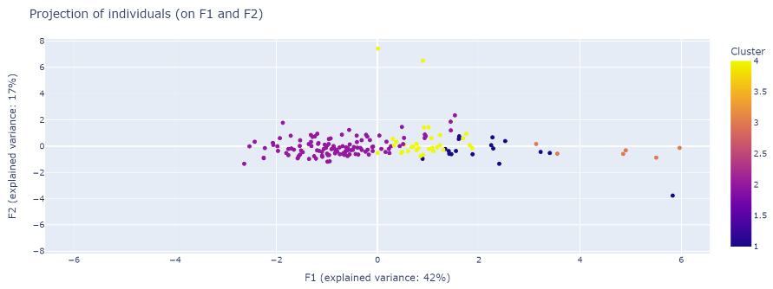
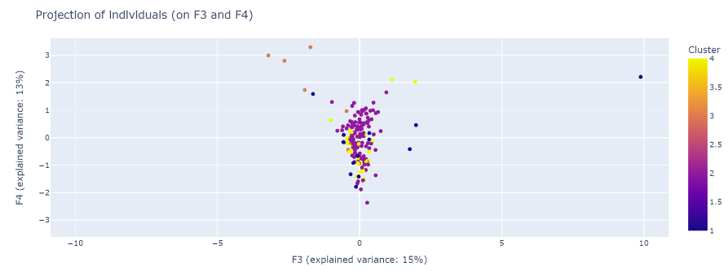
Component analysis – Visualisations – K-means
F1 – Economic prosperity
F2 – Quantity of emissions
F3 – Agricultural credit
F4 – Need for investment in agriculture

Slide 16
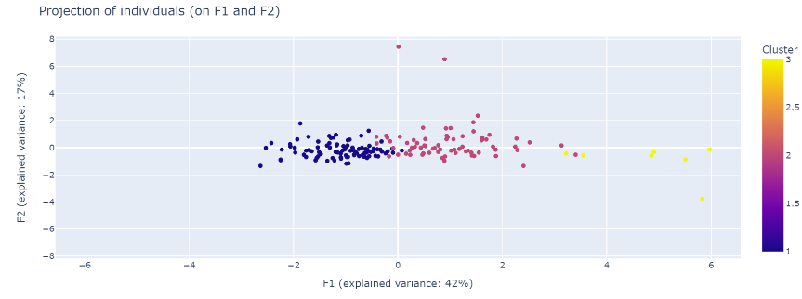
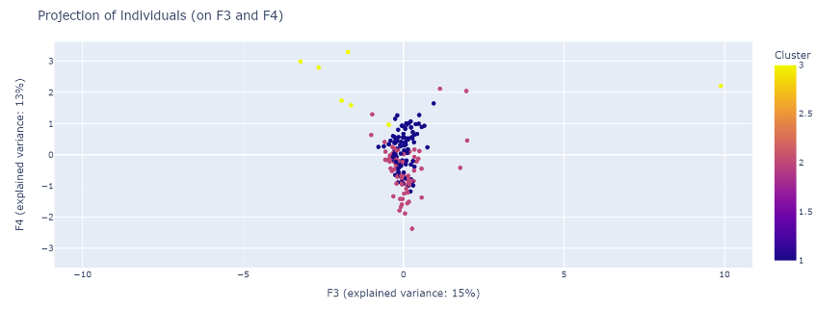
Component Analysis – Visualisations - HAC
F1 – Economic prosperity
F2 – Quantity of emissions
F3 – Agricultural credit
F4 – Need for investment in agriculture

Slide 17


International Development Best regions
Europe
Australasia (Australia and New Zealand)
A large population (24.5 million in Australia)
Lots of chicken available
Far from France – more complex regulations
The European Union
Especially Netherlands and Ireland
Simpler and cheaper for product exports.
Less chicken available could suggest demand is lower than in Australasia
Australasia

